Slide 1
Ads and in-app purchases

Slide 2
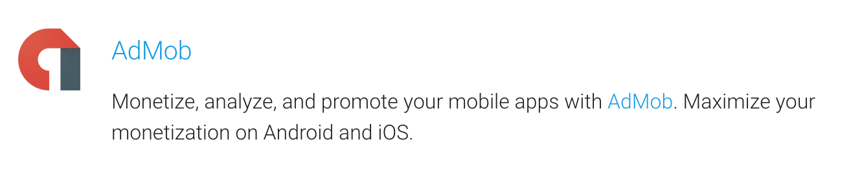
AdMob – ad network

Slide 3
AdMob overview

Slide 4
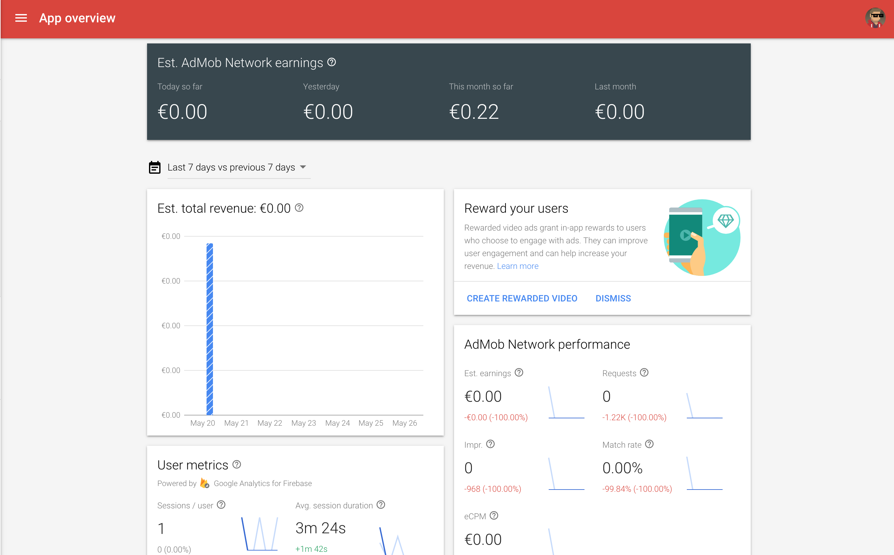
Dashboard

Slide 5
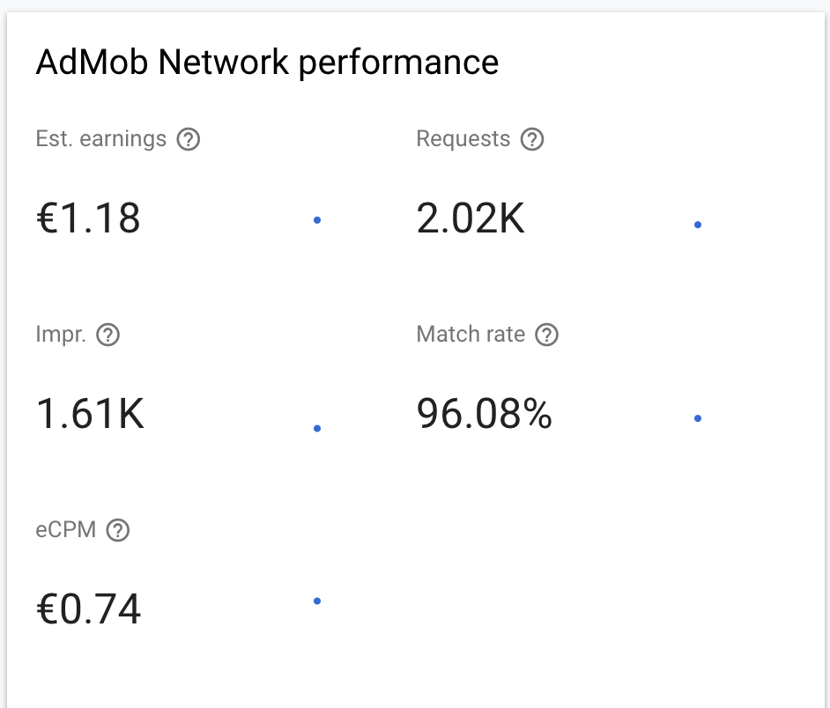
Metrics
Requests – number of times your app requested ad
Impressions – number of times app displays ad
Match rate – Impressions divided by Requests
eCPM – price for 1000 ad views
Est. earnings - amount that you earn, eCPM * impressions

Slide 6
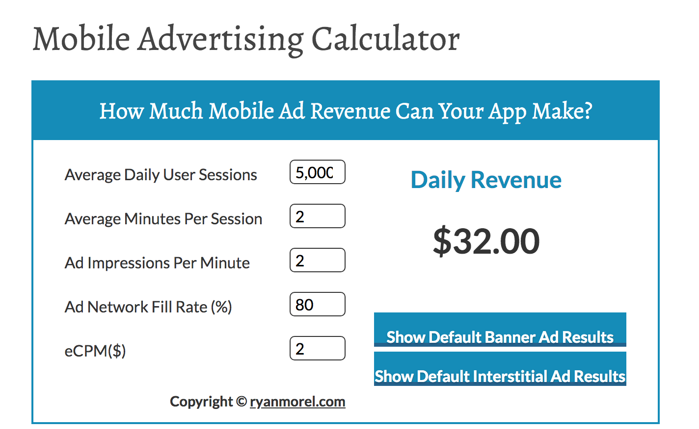
Ad revenue calculator
http://ryanmorel.com/mobile-advertising-calculator/

Slide 7
Ad variants

Slide 8
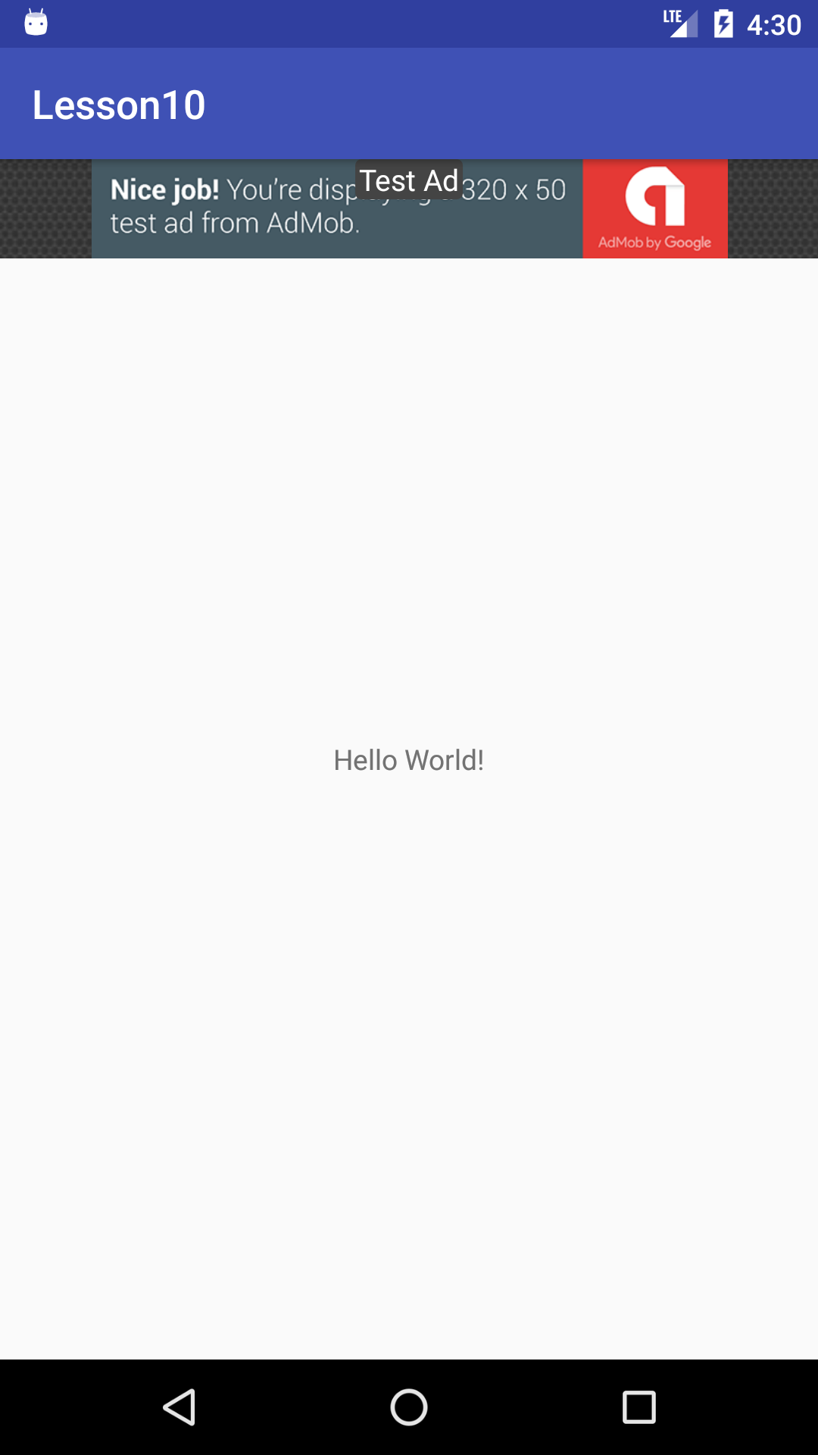
Banner

Slide 9
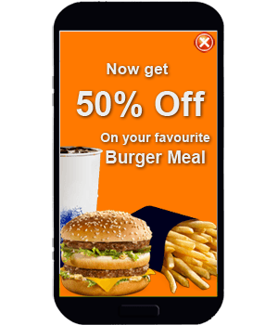
Interstitial Ads (Full screen ads)

Slide 10
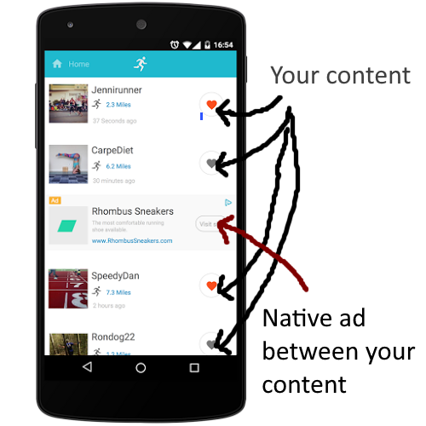
Native add

Slide 11
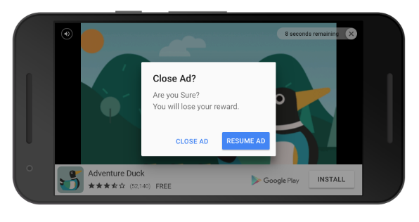
Rewarded Video Ads

Slide 12
Important things to remember:
DO NOT CLICK ON VALID ADS IN YOUR APP FROM DEVELOPMENT DEVICES!!!! YOU WOULD GET BANNED IN ADMOB!!!!
When developing, use demo IDs in order to get demo ad that does not count https://developers.google.com/admob/android/test-ads
If you did not receive ad to show, free up the space on screen if it was reserved for ad

Slide 13
How to setup ad

Slide 14
Setup AdMob console

Slide 15
Sign up for adMob
https://apps.admob.com/signup/

Slide 16
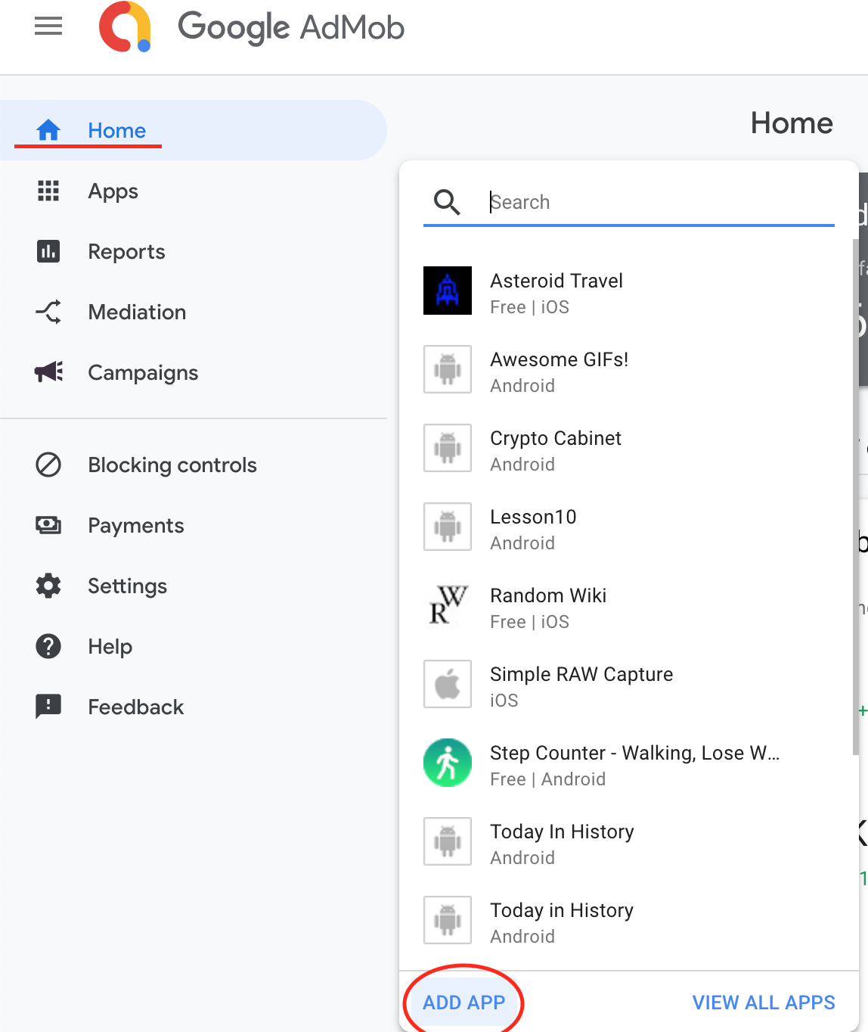
Add new app

Slide 17
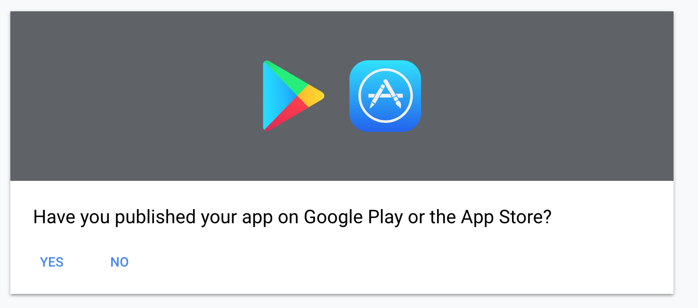
Choose

Slide 18
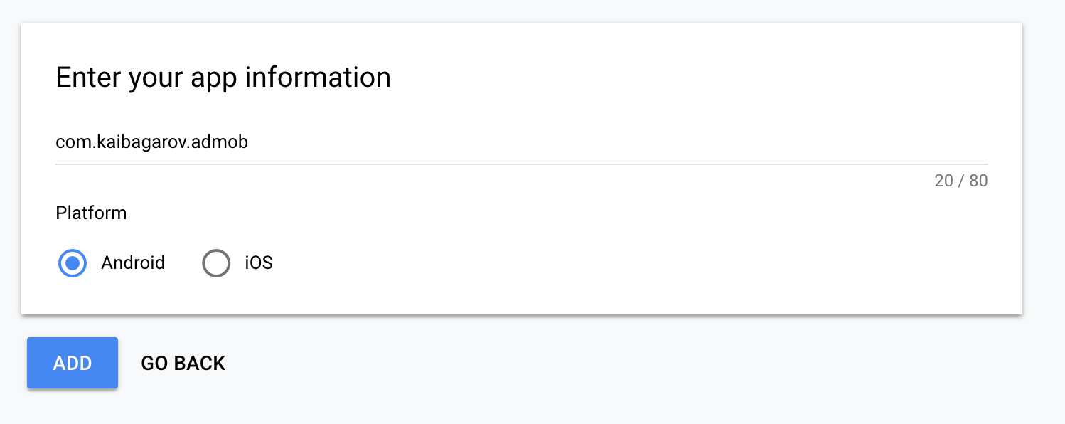
Fill info (package name and platform)

Slide 19
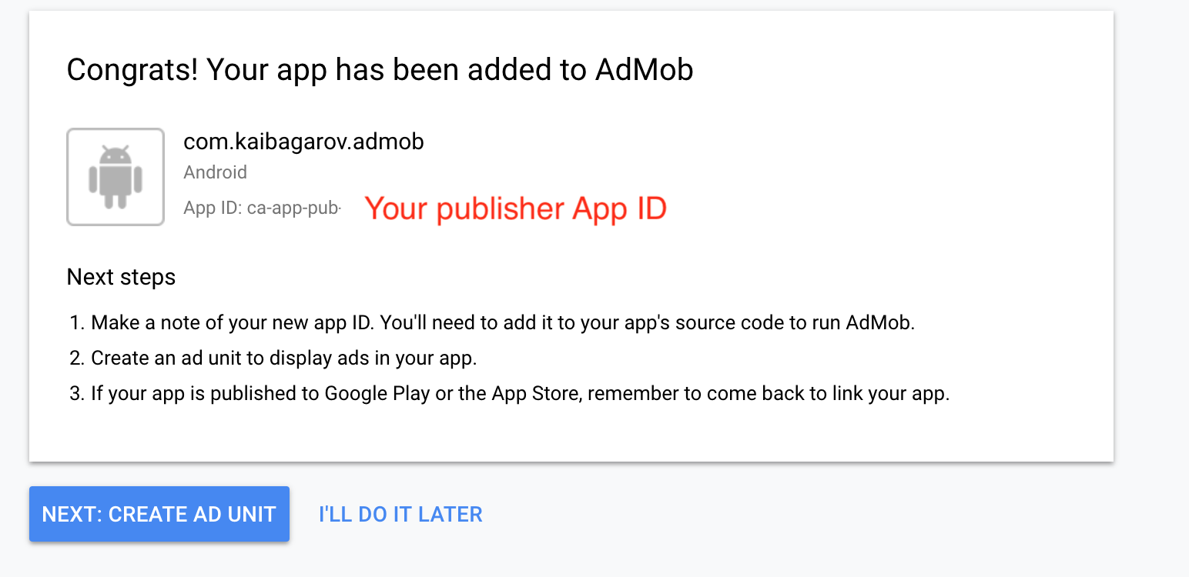
Publisher App ID is ready

Slide 20
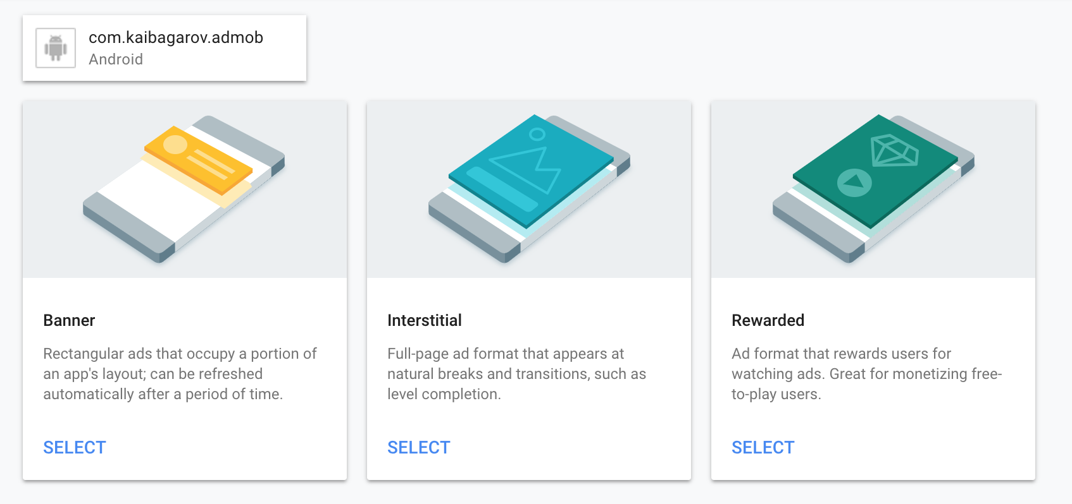
Choose AD variant

Slide 21
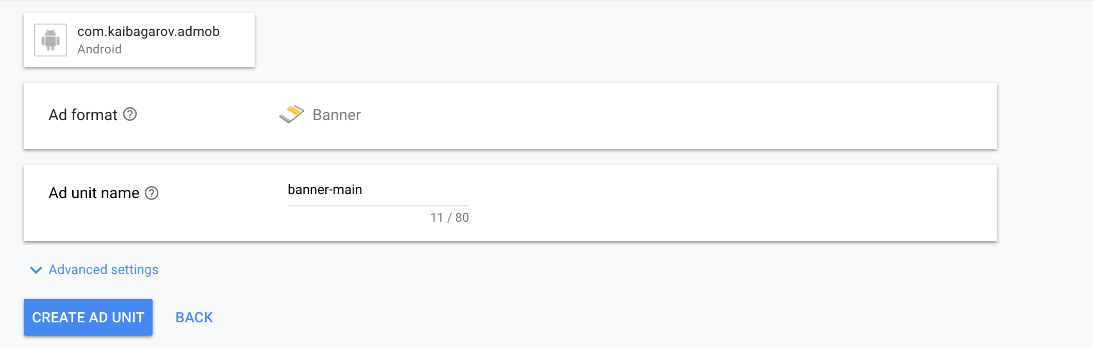
Create Banner

Slide 22
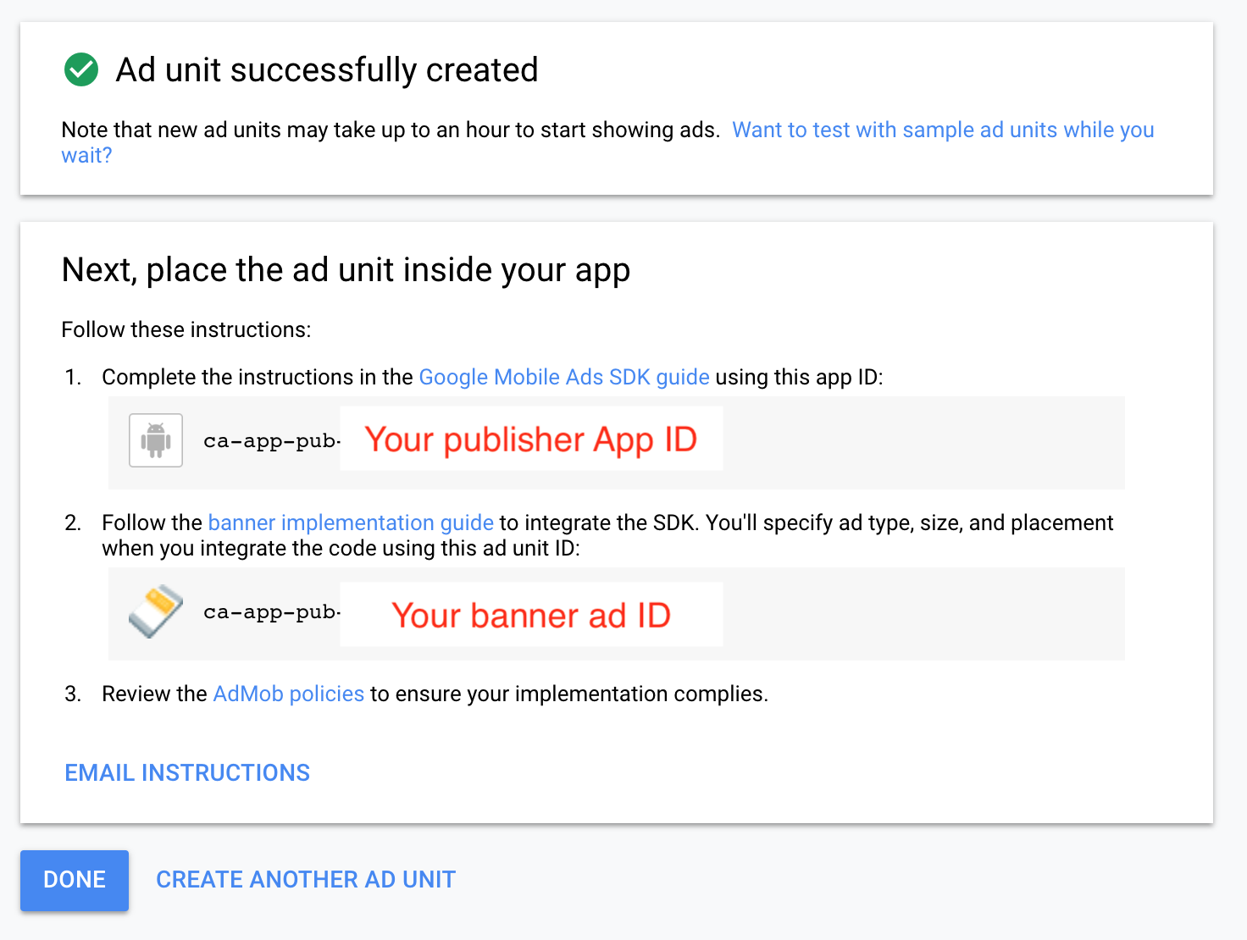
Everything is ready

Slide 23
Setup ad mob in App

Slide 24
You could use my library ☺
https://github.com/taier/AndroidHelpers
Allows to dynamically set Test Ad for development purpose
Removes Ad from UI if no Ad available
** If you would have problems installing/using it, ping me!

Slide 25
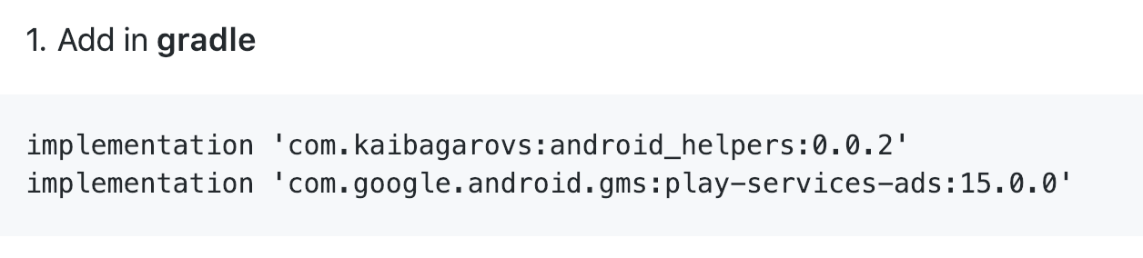
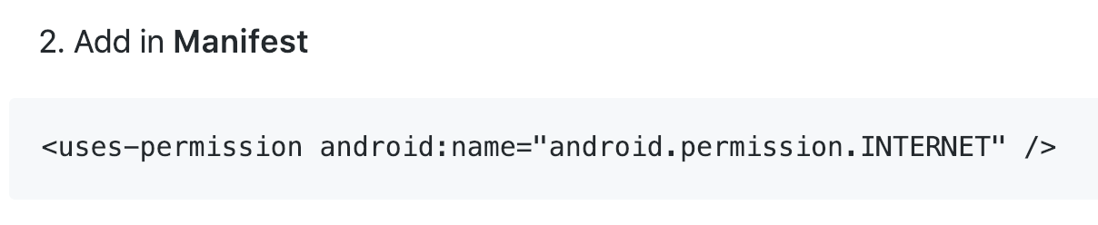
How to install

Slide 26
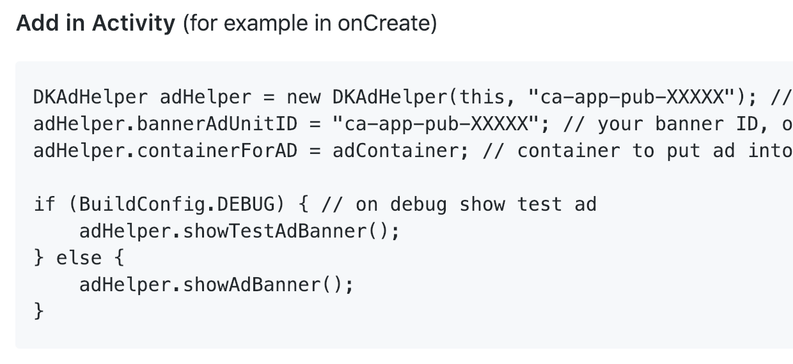
How to use

Slide 27
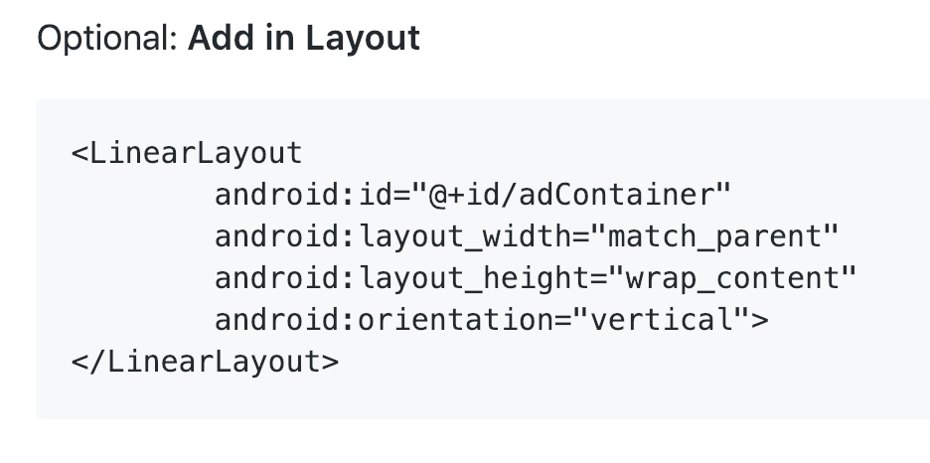
How to use

Slide 28
In-app purchases

Slide 29
In-app purcahses
You must have a payed Google developer Account in order to try it out ☹
Cant test on emulator, only real device

Slide 30
Models
Consumable
One time (option to remove ad in app)
Unlimited (buy 100/300/500/1000 crystals)
Subscriptions
These products come with a validity period (days, months, weeks, years) and are automatically renewed at the end of each billing cycle. When a subscription is not renewed, the product is no longer active for the user.

Slide 31
In-app Billing API
In App purchases is done via In-app Billing API that provides the following features:
Your app sends requests through a streamlined API that allows users to easily request product details from Google Play and order in-app products. The API quickly restores products based on the user's ownership.
The API synchronously propagates order information to the device on purchase completion.
All purchases are managed (that is, Google Play keeps track of the user's ownership of in-app products). The user can't own multiple copies of an in-app product; only one copy can be owned at any point in time.
Purchased products can be consumed. When consumed, the product reverts to the unowned state and can be purchased again from Google Play.
The API provides support for subscriptions

Slide 32
Important
You cant sell real items via in-app purchases (t-shirts, guns, drugs, etc) for that you should you Google Pay
In-app products are the digital products that you offer for sale to users from inside your application. Examples of digital products include in-game currency, application feature upgrades that enhance the user experience, and new content for your application. You can use In-app Billing to sell only digital content.

Slide 33
Important
To test in-app billing in an application you must install the application on an Android-powered device. You cannot use the Android emulator to test in-app billing. The device you use for testing must run a standard version of the Android 1.6 or later platform (API level 4 or higher), and have the most current version of the Android Market application installed.

Slide 34
Setup in-app purchases in App

Slide 35
Add permissions
<uses-permission android:name="com.android.vending.BILLING" /> <uses-permission android:name="android.permission.INTERNET" />

Slide 36
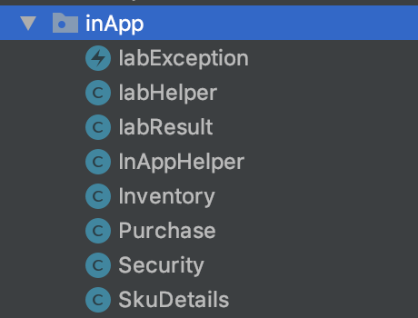
Drop a folder with wrappers

Slide 37
Drop Billing service in a special folder (src folder)

Slide 38
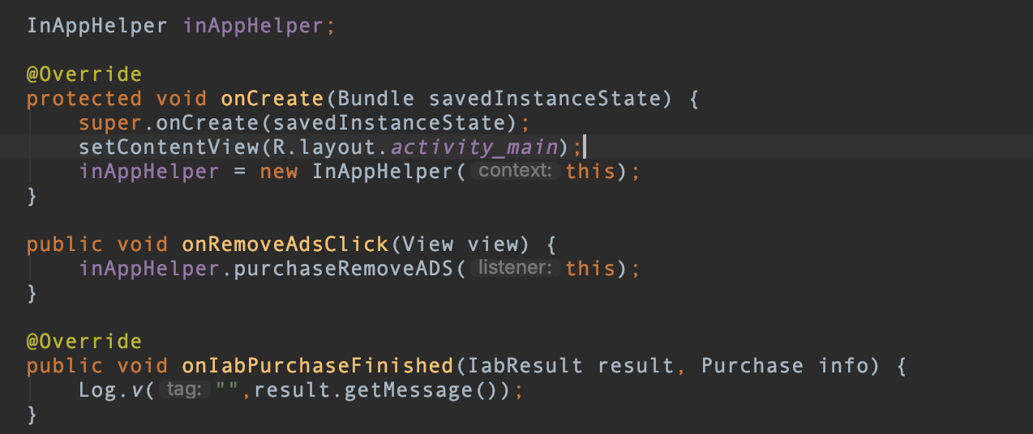
Example

Slide 39
Then build & upload build to Google play

Slide 40
Setup in-app purchases in google console (Next lecture)

Slide 41
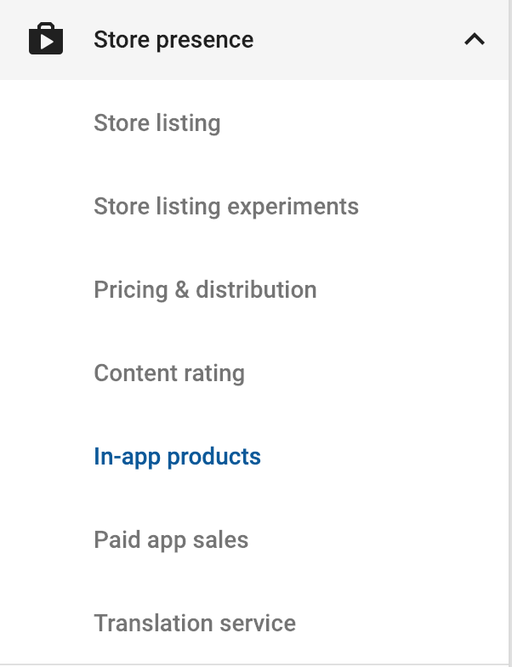
Navigate to In-app products

Slide 42
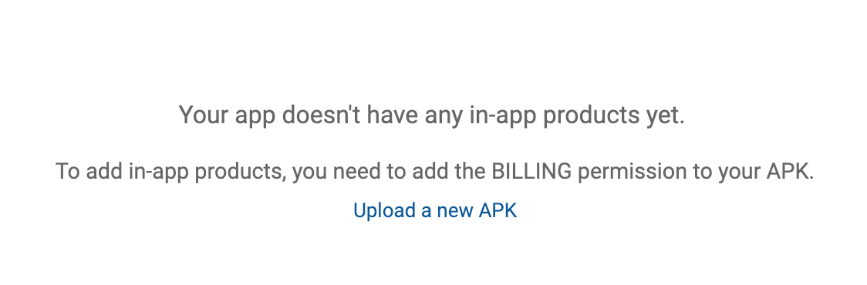
Billing permission
Add Billing permission to your app and upload a new build to a betta channel, or you would see:

Slide 43
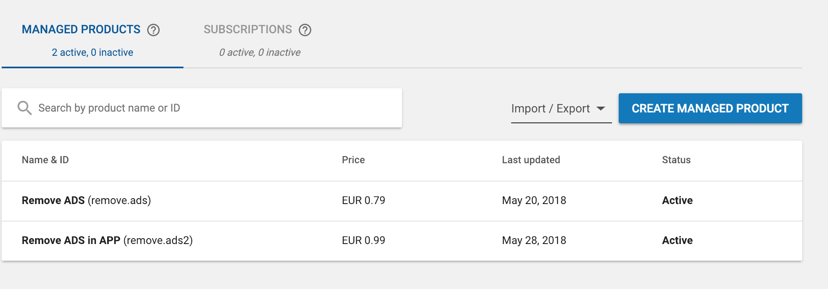
Create product

Slide 44
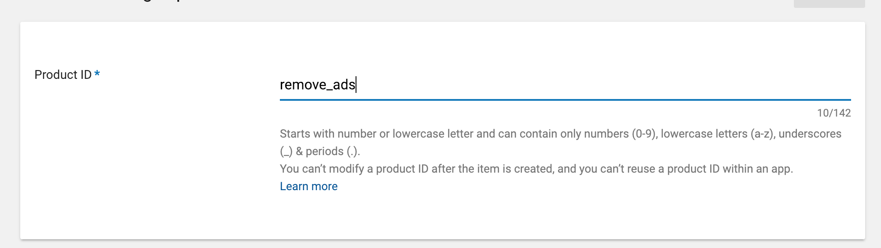
Set product ID

Slide 45
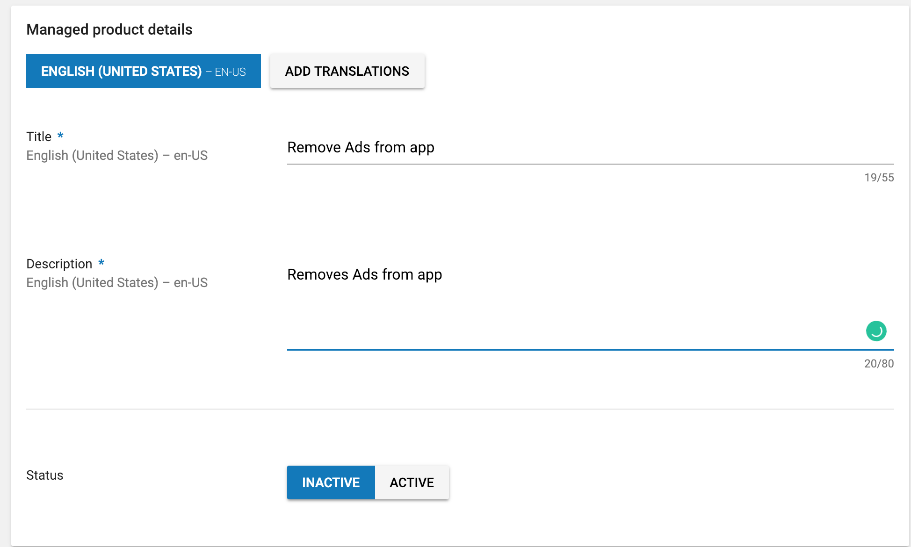
Set title and description

Slide 46
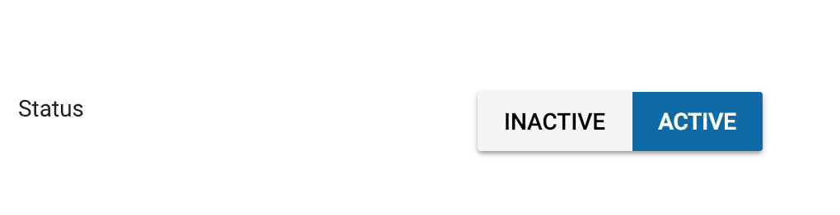
Set status to active

Slide 47
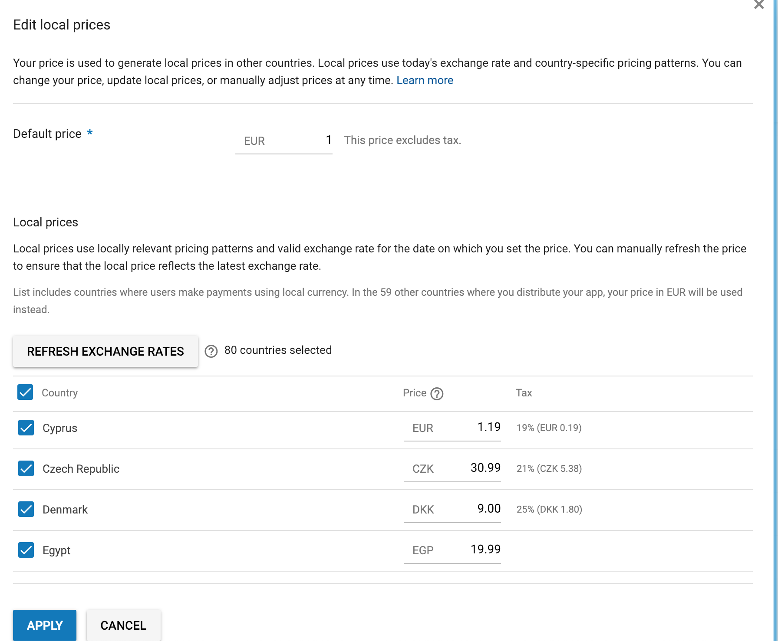
Set price

Slide 48
Additional fields for Subscription

Slide 49
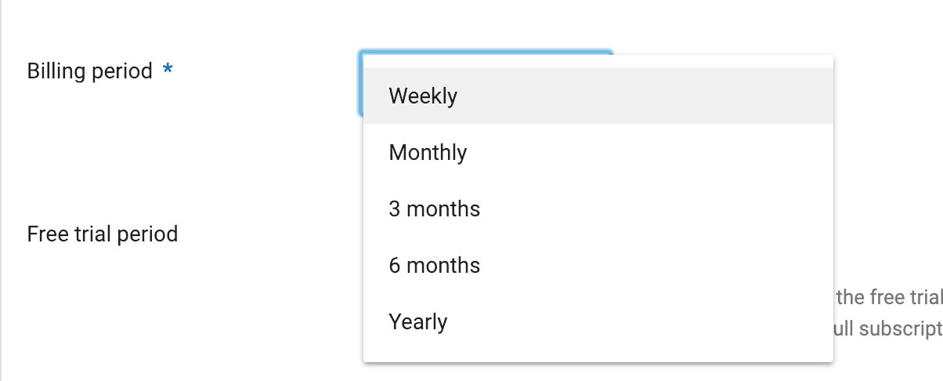
Billing frequency

Slide 50
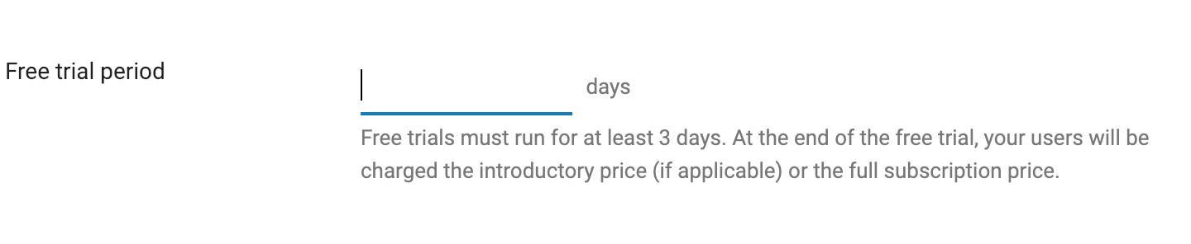
You could set trial time

Slide 51
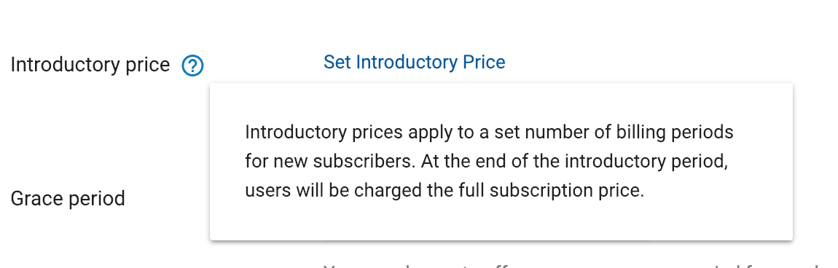
Price for first few billing cycles

Slide 52
publishing app in beta in order to generate public Key (next lecture)

Slide 53
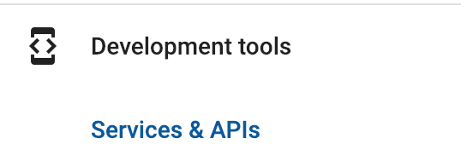
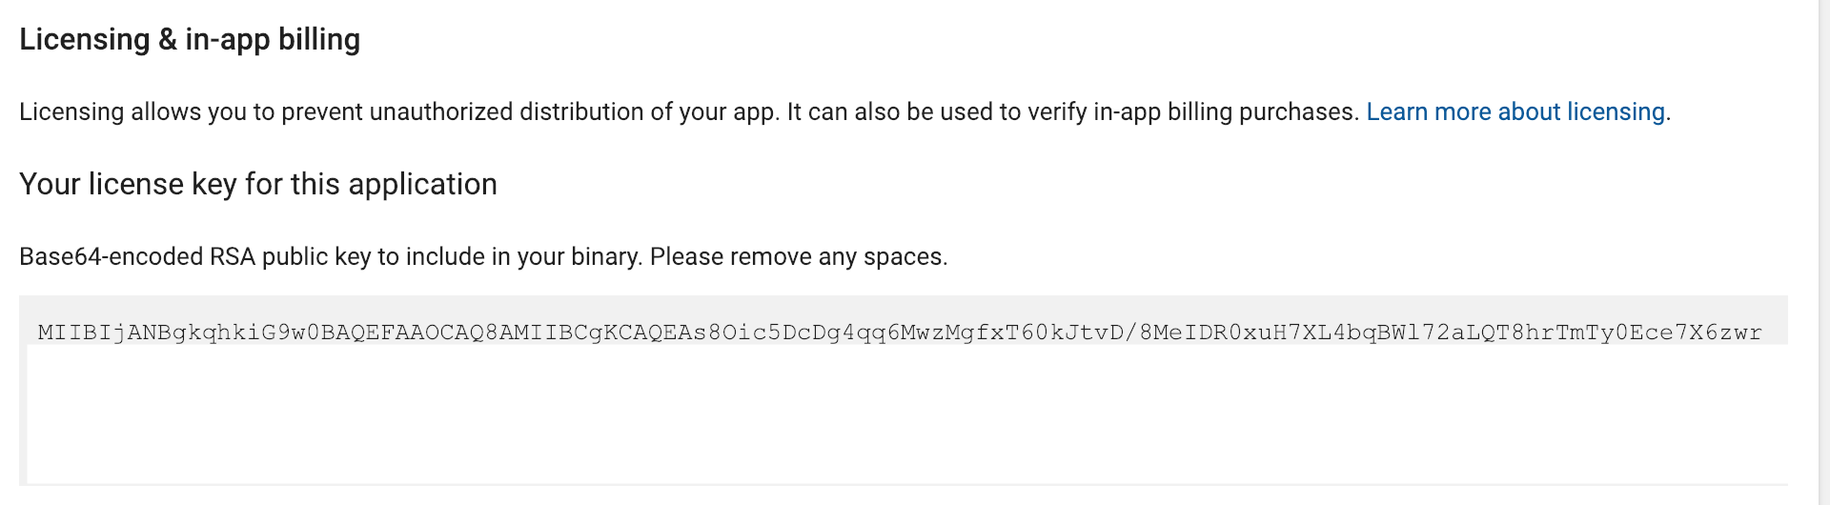
Obtain public key of you app

Slide 54
Set variables in app
Public key – key that you obtained from google play
ProductID – product name that you created (remove.ads)

Slide 55
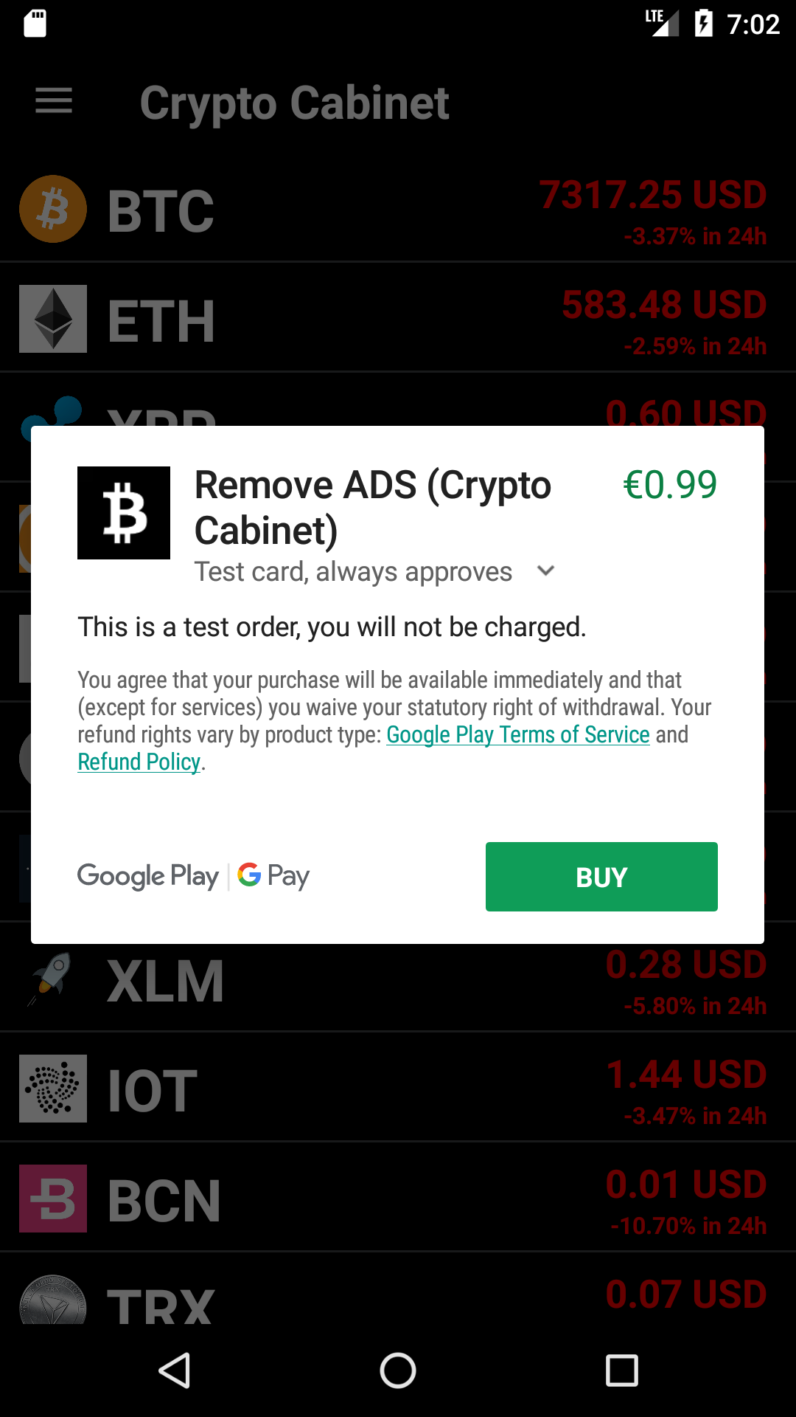
Should look like that

Slide 56
Homework
Integrate Ad Mob into Lesson10 code (or in your version)

